Slide 1

Minor project - I
Course code : 14B19CI591
Title: Social networking webapp
Project No.:- 85
Rishi Prajapati(161B177)
Garvit Singh (161B079)
Samarth Srivastava(161B193)
Project Guide:
Mr. Navaljeet Singh

Slide 2

Content
AIM BEHIND MAKING THIS PROJECT
BRIEF DESCRIPTION
DETAIL DESCRIPTION
SCREENSHOTS
TECHNICAL REQUIREMENTS & TOOLS
WEB ARCHITECTURE
USE CASE DIAGRAM
PROCESS ARCHITECTURE

Slide 3

Aim of the project
The aim of the project is to reflect the full functionality of a responsive website (Back end and Front end) by using latest Back End Technology i.e. NODE.JS and we want to enhance our knowledge and skills in NODE.JS so that we can ourselves MEAN/MERN Stack Developer

Slide 4

Brief description
Our aim is to build a website through which developers can connect to each other and discuss their queries according to their interest.
The targeted audience would be the Developers and other people who want to hire them.
It is like a question-and-answer site where questions are asked, answered, edited, and organized by its community of users in the form of opinions.

Slide 5



Detailed description
The website will be fully responsive that will work on both Desktop and mobile phones/tablets.
Secure login procedure.
The website will be basically a small social network platform for developers.
We can look at the profiles and we can login and create our own profiles, we can add our experiences.
We can also add post and comment, basically a query where other users can share opinions.
You don’t have to be logged in or signed to actually see the developers that are registered.
You can look at the profile of the registered developer.
Once logged, you can see the dashboard and can edit your profile.
We can also delete the entire account.

Slide 6


Technical requirements and languages
1. ES7 react/redux snippets. 2. Node.js modules intellisense.
Main technologies used
ES6+ JavaScript
Node.js/express
MongoDB
React and Redux
Tools used

Slide 7
WEBSITE Architecture
Home
Terms of use
Privacy Policy
Site Map
My account
Community
Write Something
Upload Something
About US
Support
login
No
yes
Members
Blogs
Videos
Team
Contact
Register
Dashboard
Group
Forums
Photos
Management
FAQs
Confirmation
Account setting
Events
Advertise
Message center
My Profile

Slide 8
Use case diagram
Register profile
Edit Profile
Check User Account
Delete User Profile
Send/receive message
System announcement
User
Admin
System Updates
posts
uploads
Send Friend request

Slide 9
ACTIVITY Diagram
Start
Home Page
Register
Login
Username
Name
E-mail
Age
Password
Year
If Successful
Yes
NO
Login Fail
E-mail
Yes
Department
Chat Start
Search for friends
Logout

Slide 10
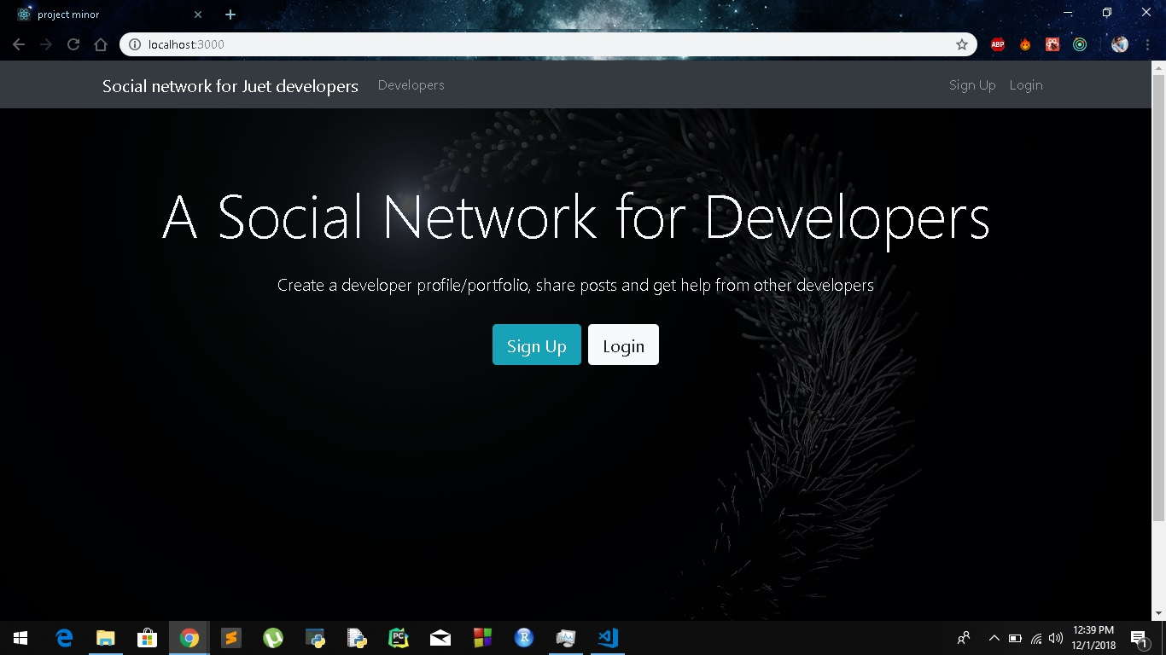

Slide 11
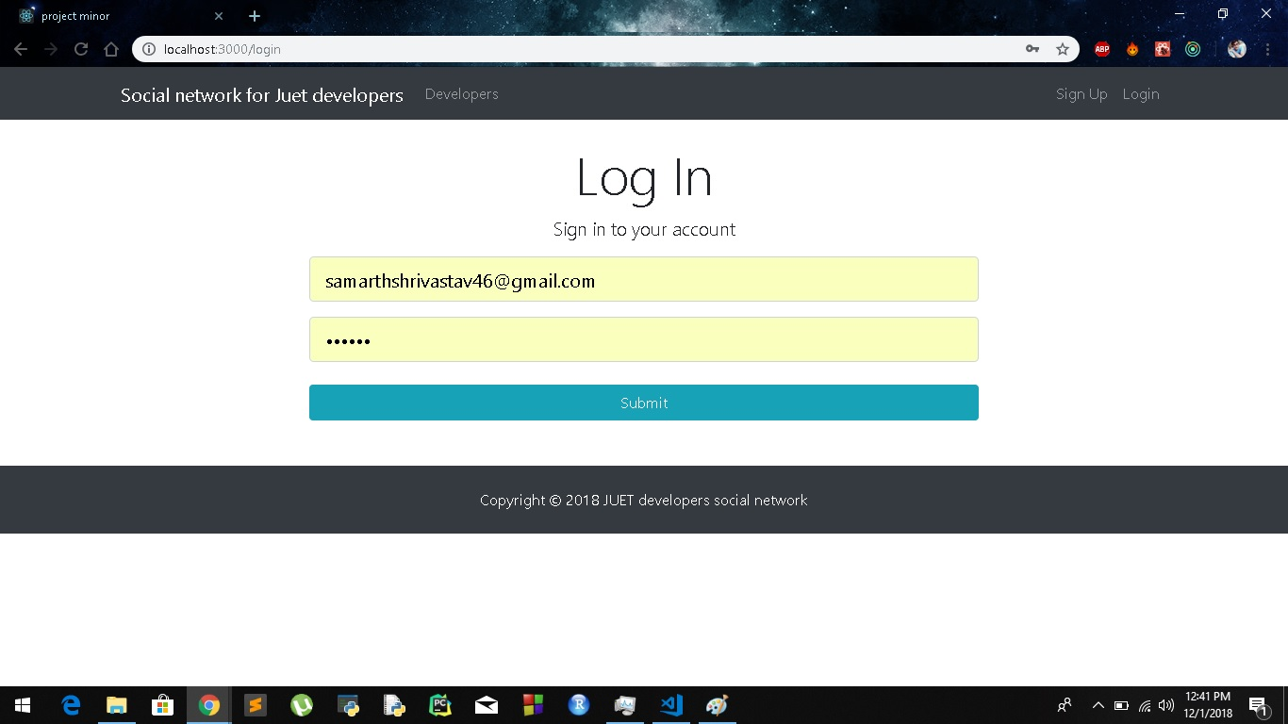

Slide 12
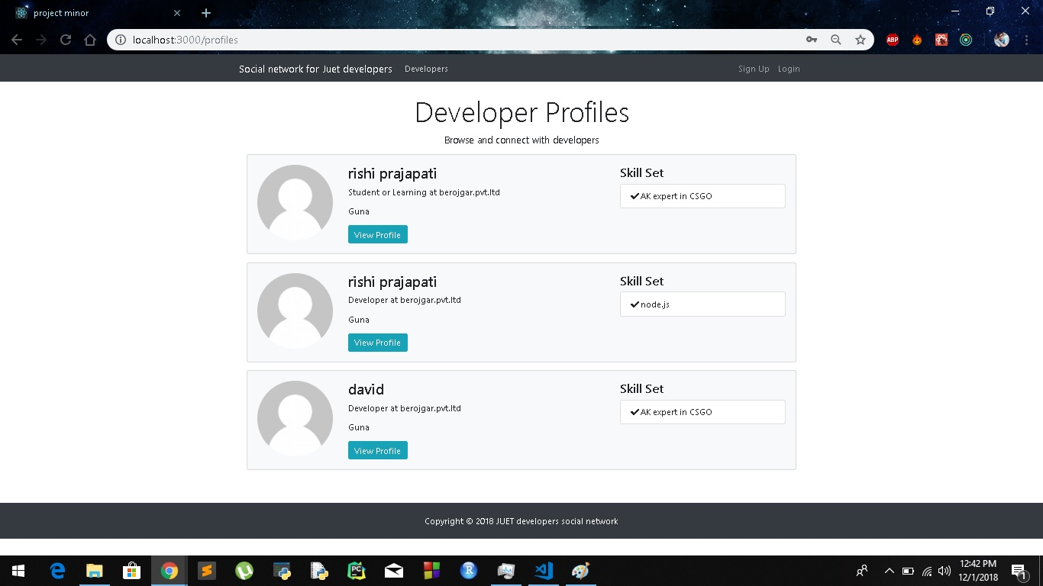

Slide 13
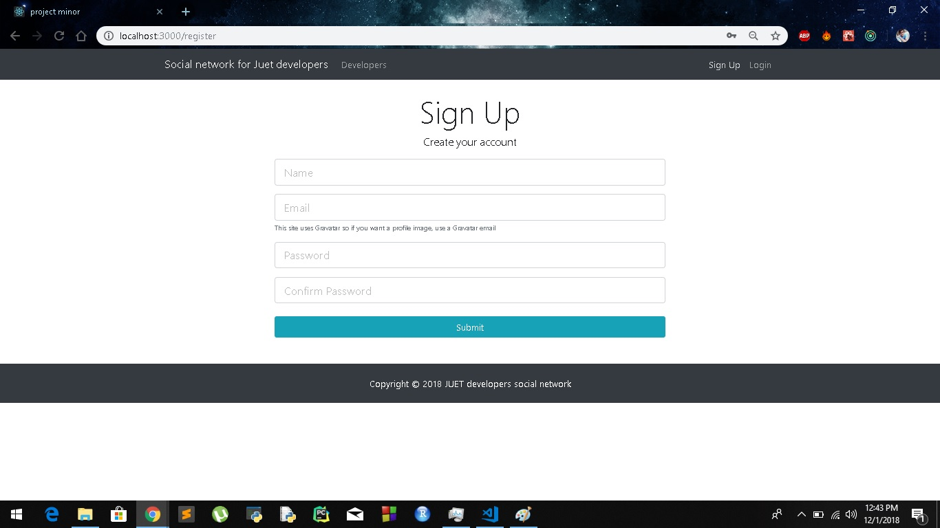

Slide 14
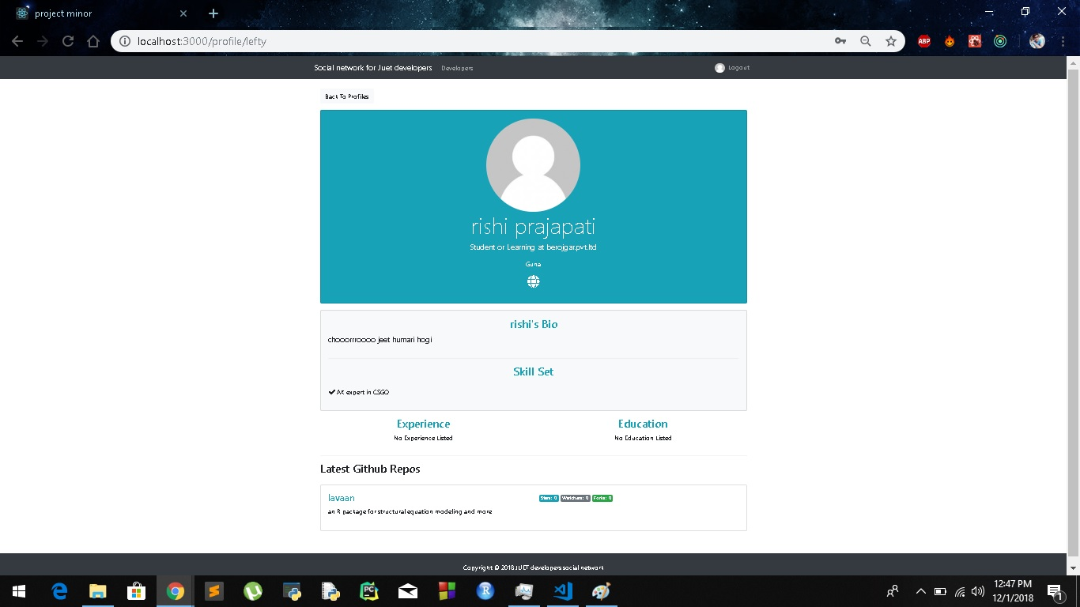

Slide 15
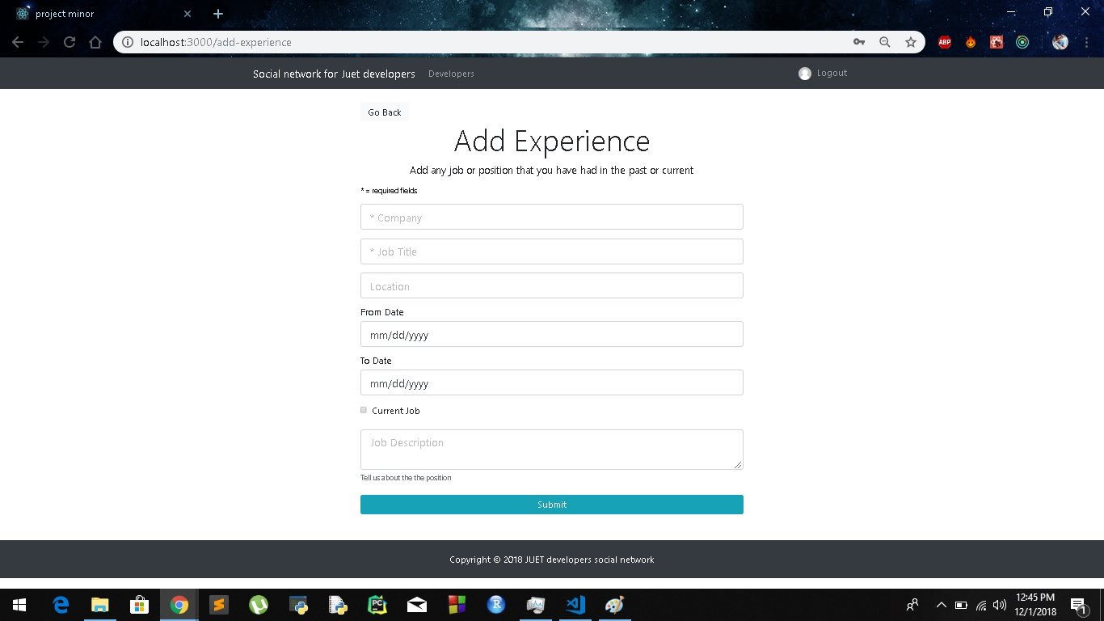

Slide 16

Thank you
Flora@contoso.com
http://www.contoso.com/

